Slide 1

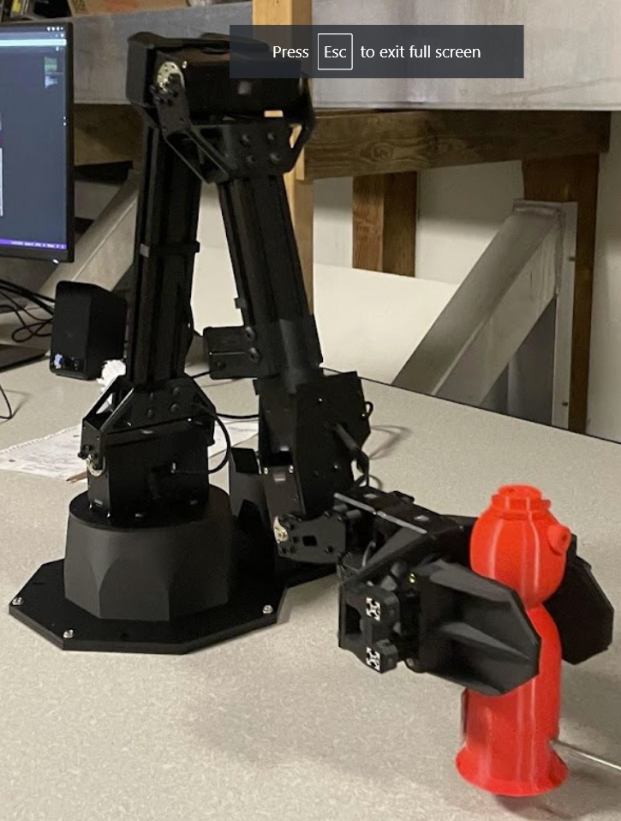
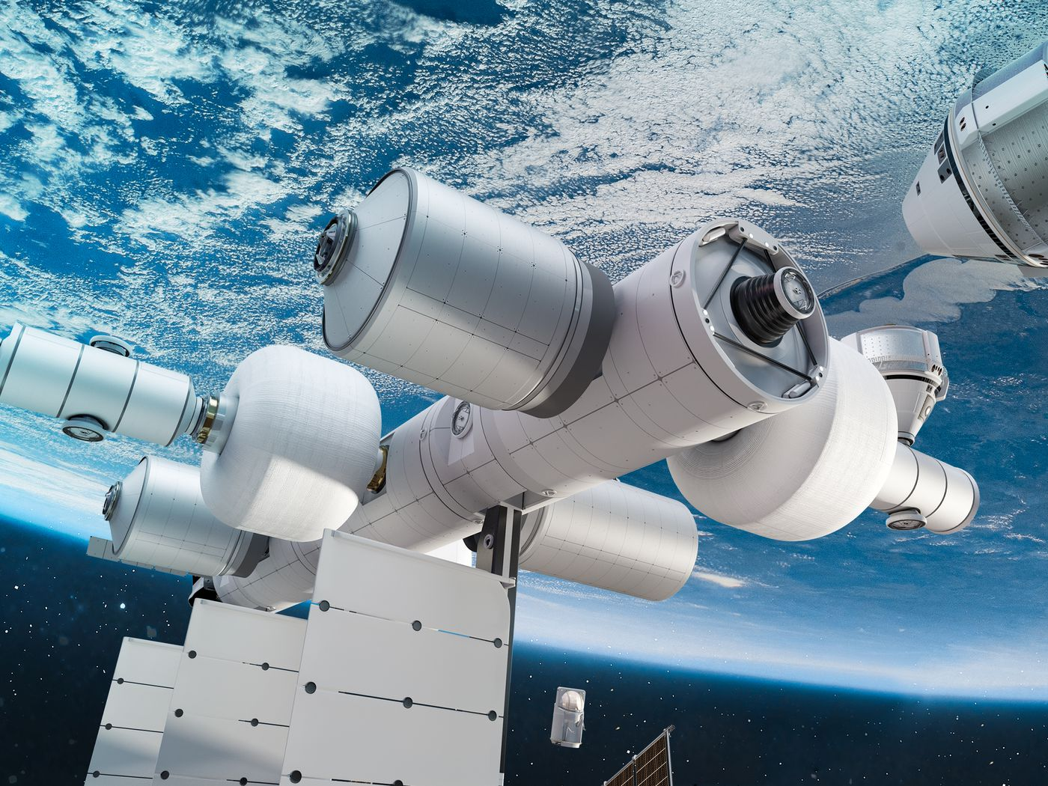
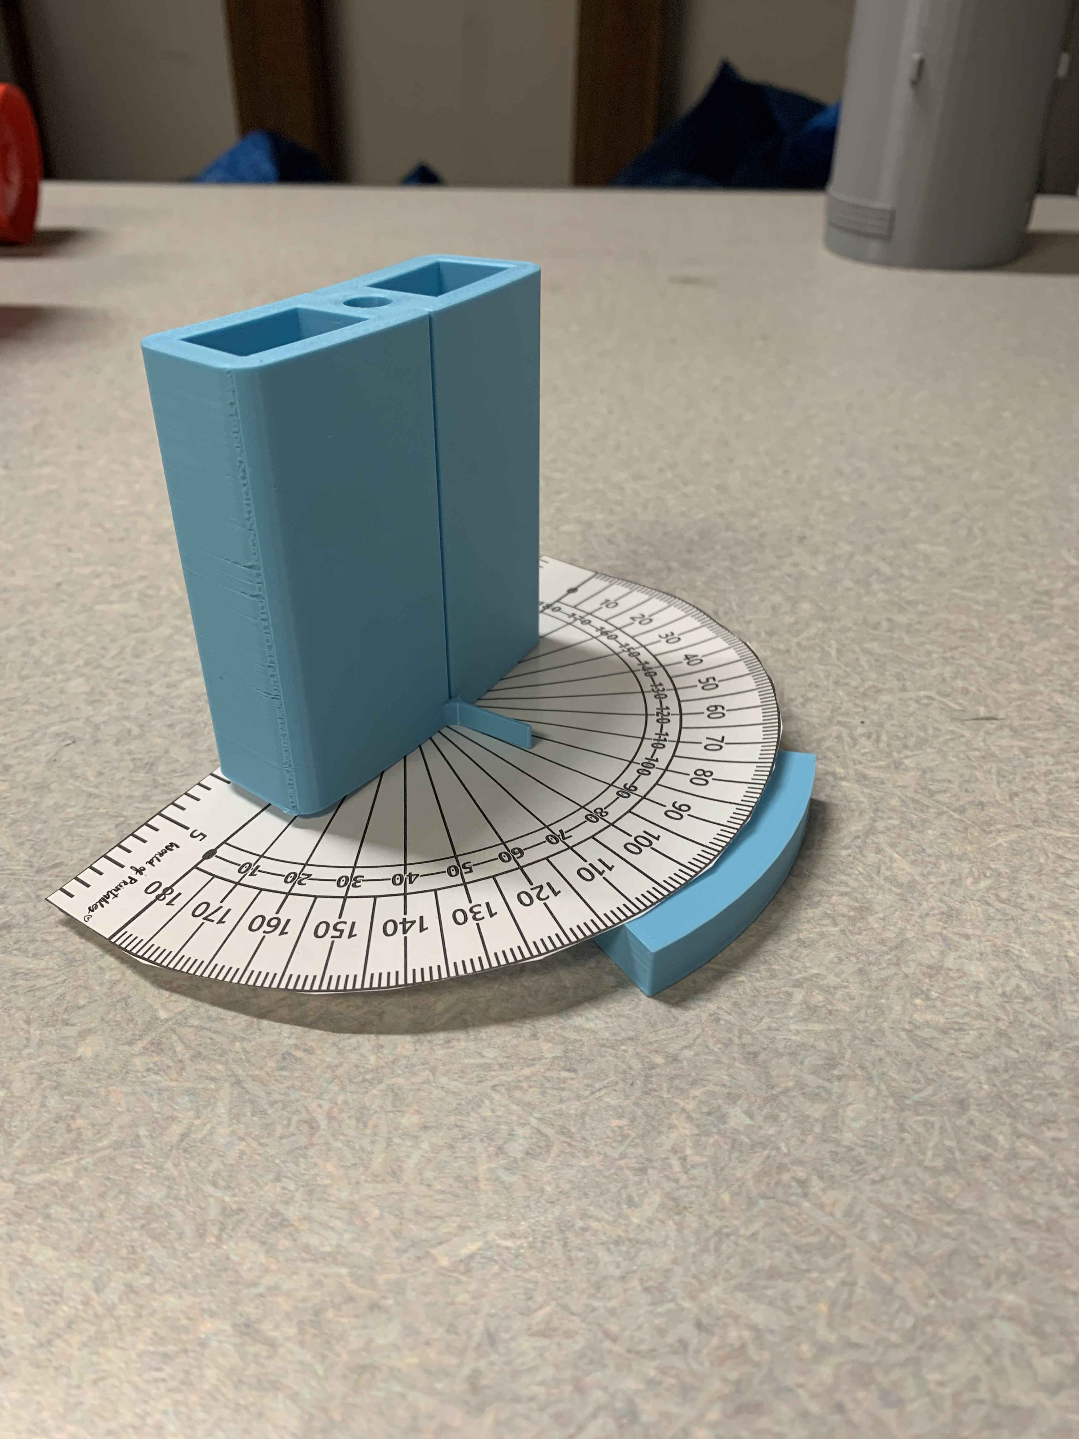
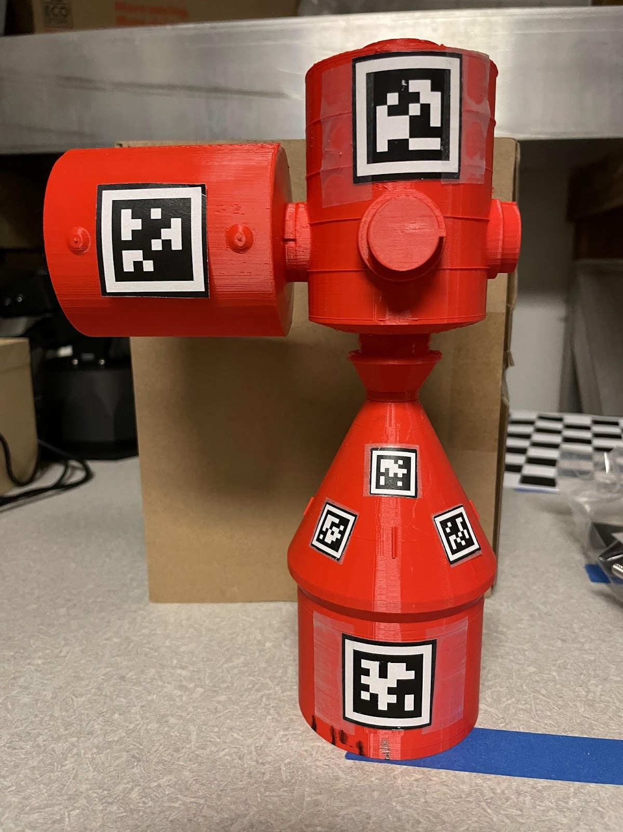
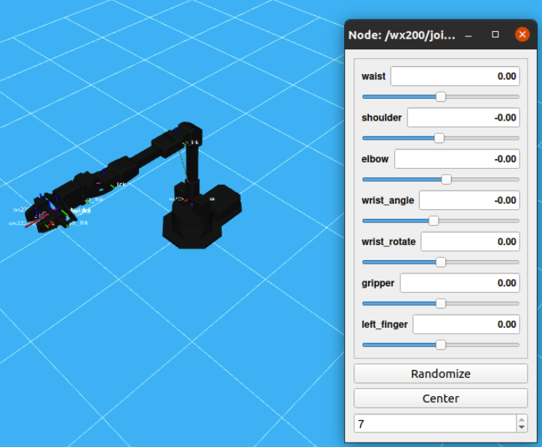

AprilTag Applications
to Autonomous Spacecraft Docking
STUDENT(S): NICHOLAS ANDREWS, JOSHUA CHENG, HARRY FUREY-SOPER, KAYLEE HUDSON
Spacecraft Docking Applications
Testbed & Robot Operating System (ROS)
Future Work
The spaceflight industry has expanded rapidly in recent years. As spaceflight missions increase in frequency, it is of increasing importance to improve the efficiency and reliability of spacecraft maneuvers.
The Nonlinear Dynamics and Control Laboratory has partnered with Blue Origin to develop a control system which will use fiducial markers in localization, guidance, and navigation for autonomous spacecraft docking. This will help streamline many common mission profiles, including:
Personnel Transport
Supply Exchange
Refueling
Repair & Maintenance
Debris Removal
ROS: Background
The control system will be bench-tested using 6DOF robotic manipulator arms to carry camera-equipped spacecraft models through simulated orbital trajectories.
ROS, or Robot Operating System, is an open-source collection of software libraries which is being used to program the robotic arms.
Next Steps for Robot Programming
Future and testing are underway in these areas:
Develoresearchpment of the Gazebo model
Development of the inverse kinematics model (MoveIt)
Implementation of a feedback loop into robotic controls
Improving AprilTag Characterization
The preliminary study of AprilTag accuracy should be expanded on to achieve a more thorough understanding of their potential performance at scale.
ROS: Physical System
The objective is to set up a pair of robotic manipulators that can carry a camera (observer) and a spacecraft model with AprilTags attached (target). The trajectory of the observer could then be controlled through a feedback loop using data from the AprilTag-camera system.
Over the last year, the adaptation of existing single-arm configurations to a dual-arm configuration has been under development:
Adaptation of existing Xacro/UDRF models for dual-arm
Adaptation of launch files for dual-arm
Visualization of the dual-arm system in RViz
Determine reasonable tag size to distance ratios from desired mission capabilities​
Determine reasonable tag size to curvature ratios based on modern spacecraft fleets​
Collect significant data within these regimes​
Establish general rules of AprilTag placement on a spacecraft to guarantee accurate motion tracking from any angle
​
[2]
Past Work: Fiducial Markers
AprilTag is a type of fiducial marker, a specific collection of 2D barcodes. When placed on a known object, observation of the markers can be used to calculate relative distance and orientation of the object.
AprilTag accuracies were tested with several variables to predict spacecraft applicability:
Surface curvature
Distance from camera
Tag size
Orientation relative to camera
Shadow obfuscation
[2]
ROS: Simulation
Before running physical tests, planned trajectories will be demonstrated in virtual simulations
This will help prevent unwanted collisions during testing
Motion planning tools interface with the ROS simulation platform, Gazebo
References and Acknowledgments
Faculty: Kristi Morgansen
Graduate Students: Nicholas Andrews
Other: Nathan Powel (Blue Origin)
ADVISERS: KRISTI MORGANSEN
SPONSORS: BLUE ORIGIN

